Slide 1
Design and Analysis of Algorithms
CS602
Optional Session
A generic way to design Greedy Algorithms

Slide 2
Recap of last lecture

Slide 3








A generic way to design and analyse a greedy algorithm
P: a given optimization problem
So, all you need is to just design the Greedy step appropriately.
Opt($A$)
$$A$$
instance of size $n$of problem P
Greedy
step
?
Opt($A′$)
$$A′$$
instance of size $<n$of problem P
Greedy
step
Yes, a simple recursive algorithm.☺
$$A′′$$
…
Opt($A′$)
Base case
Notes:
Let us illustrate its usefulness with the help of an example.

Slide 4
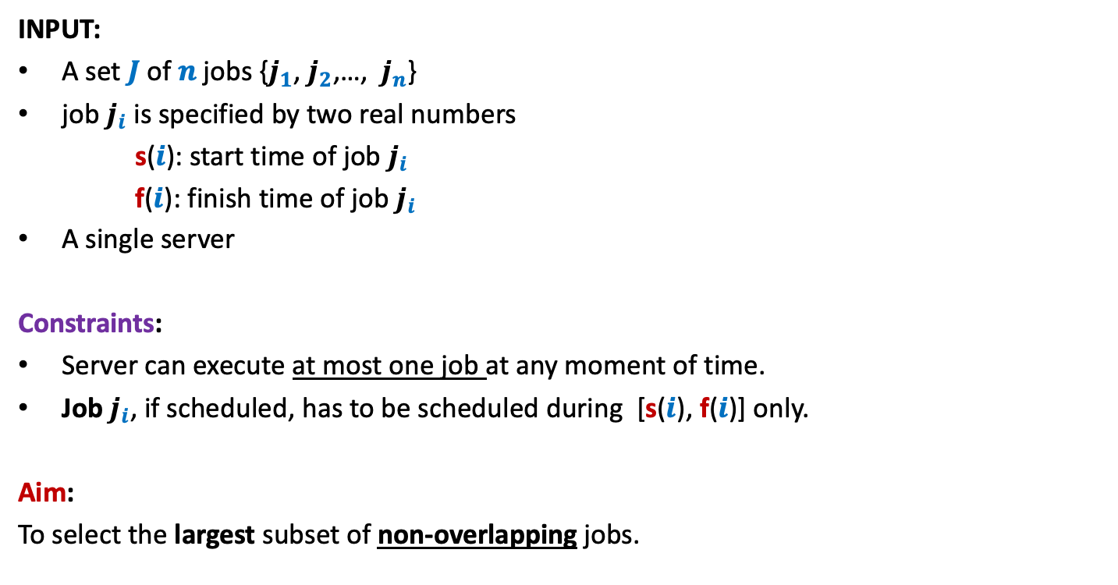
A job scheduling problem
Formal Description
INPUT:
A set $J$of $n$ jobs {$j_{1}$, $j_{2}$,…, $j_{n}$}
job $j_{i}$ is specified by two real numbers
s($i$): start time of job $j_{i}$
f($i$): finish time of job $j_{i}$
A single server
Constraints:
Server can execute at most one job at any moment of time.
Job $j_{i}$, if scheduled, has to be scheduled during [s($i$), f($i$)] only.
Aim:
To select the largest subset of non-overlapping jobs.

Slide 5
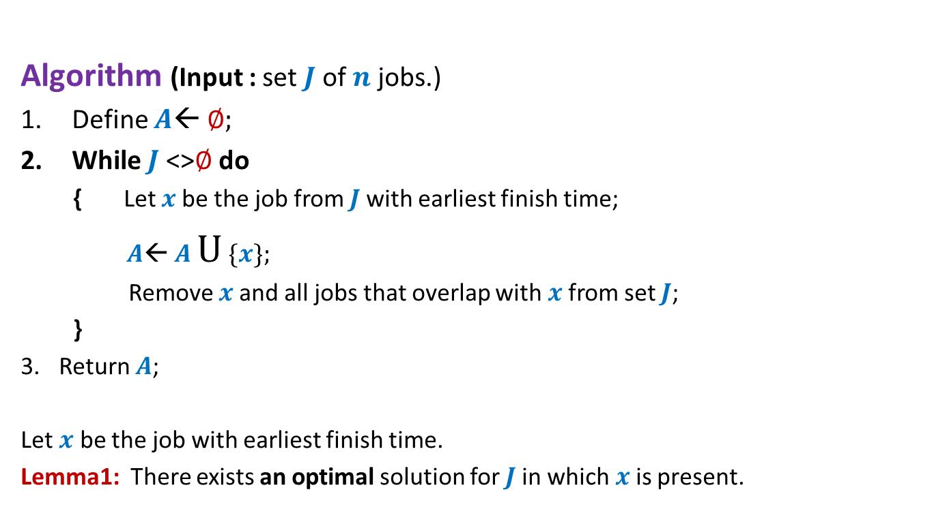
Algorithm “earliest finish time” Description
Algorithm (Input : set $J$of $n$ jobs.)
Define $A$← ∅;
While $J$<>∅ do
{ Let $x$be the job from $J$with earliest finish time;
$A$← $A$ U {$x$};
Remove $x$and all jobs that overlap with $x$from set $J$;
}
Return $A$;
Let $x$ be the job with earliest finish time.
Lemma1: There exists an optimal solution for $J$in which $x$is present.

Slide 6

Algorithm “earliest finish time” Description
Algorithm (Input : set $J$of $n$ jobs.)
Define $A$← ∅;
While $J$<>∅ do
{ Let $x$be the job from $J$with earliest finish time;
$A$← $A$ U {$x$};
Remove $x$and all jobs that overlap with $x$from set $J$;
}
Return $A$;
Let $x$ be the job with earliest finish time.
Lemma1: There exists an optimal solution for $J$in which $x$is present.
OPT($J$) = {$x$} U OPT($J$ \ Overlap($x$))

Slide 7


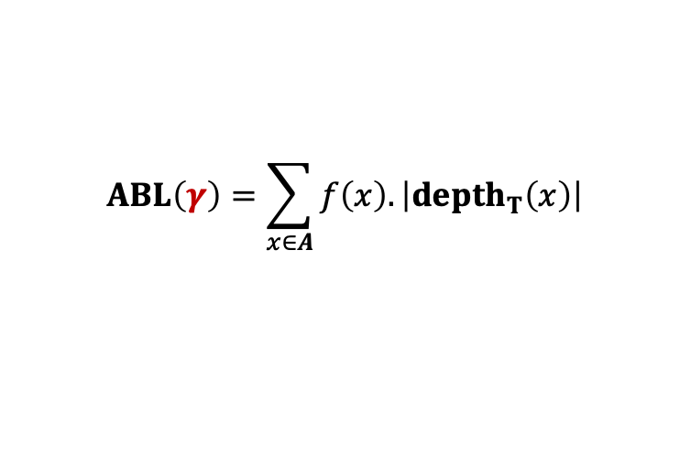

The binary tree of the optimal prefix code
0
1
0
1
0
1
. . .
1
0
1
Deepest level
$$a_{1}$$
$$a_{2}$$
Theorem: There exists an optimal prefix coding
in which $a_{1}$and $a_{2}$ appear as siblings
$$ABL\left(γ\right)=\sum_{x∈A}{f\left(x\right).\left|depth_{T}\left(x\right)\right|}$$

Slide 8
Finding the labeled binary tree for
the optimal prefix codes

Slide 9
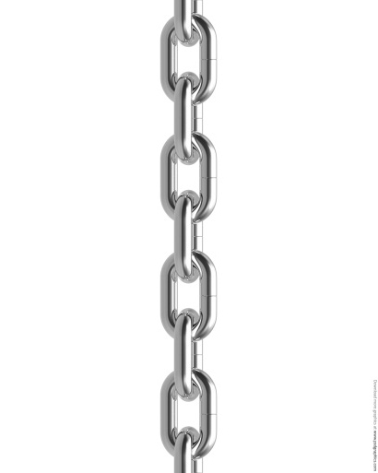



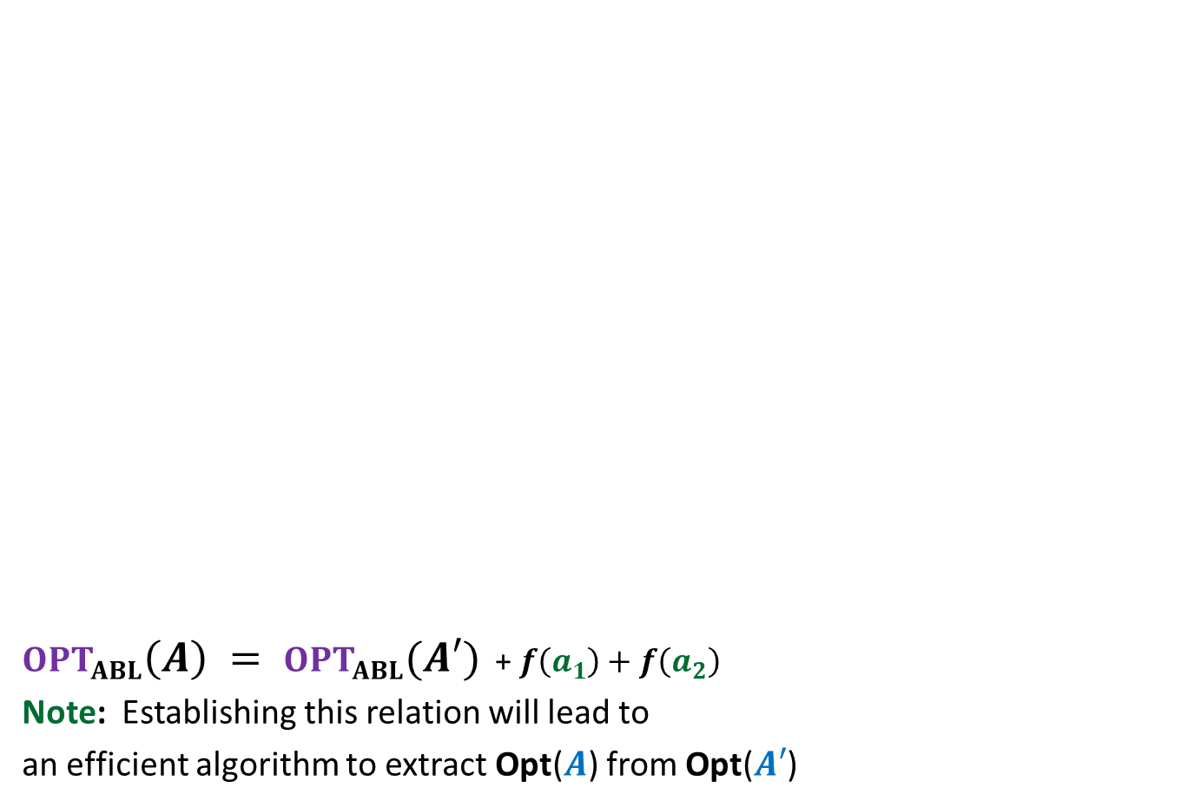





$OPT_{ABL}\left(A\right) = OPT_{ABL}(A′)$ + $f\left(a_{1}\right)+f\left(a_{2}\right)$
Note: Establishing this relation will lead to
an efficient algorithm to extract Opt($A$) from Opt($A′$)
Opt($A$)
$$A$$
$a_{1}$, $a_{2}$, $a_{3}$ , … … $a_{n}$
Greedy
step
Relation ?
Opt($A′$)
$$A′$$
$a_{3}$ , … … $a_{n}$
$$a′$$
$f\left(a\text{’}\right)=$ $f\left(a_{1}\right)+f\left(a_{2}\right)$
?

Slide 10
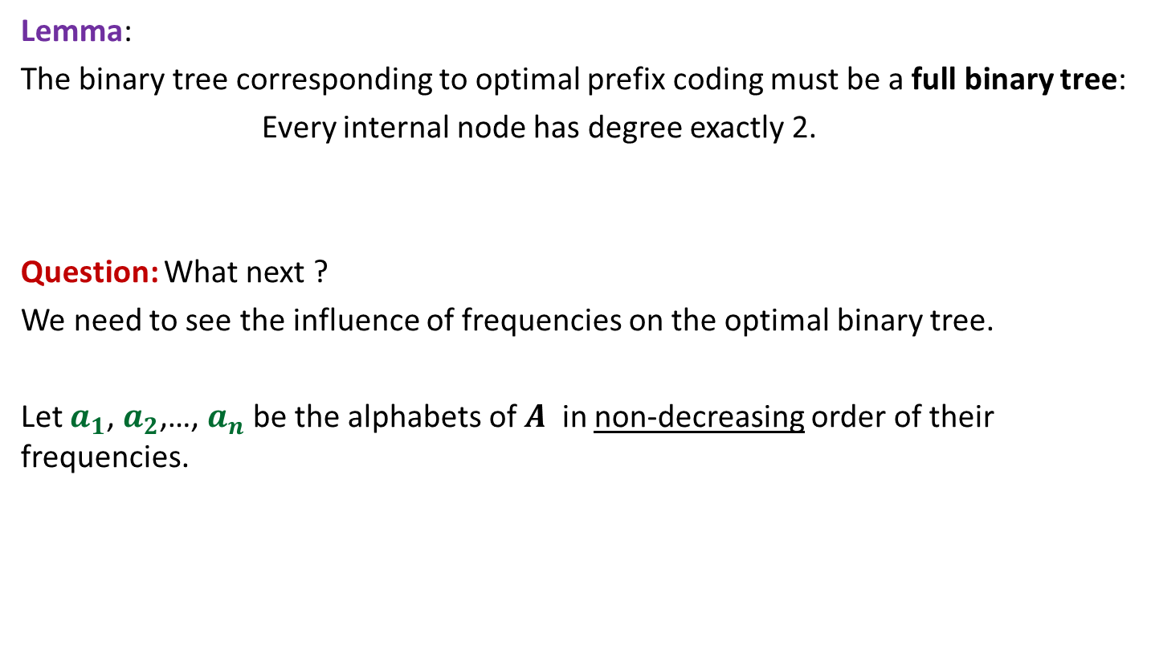
Proof for $OPT_{ABL}\left(A\right)=OPT_{ABL}(A′)$ + $f\left(a_{1}\right)+f\left(a_{2}\right)$
Spend some time thinking about the proof
before moving ahead.
☺

Slide 11
Proof for $OPT_{ABL}\left(A\right)=OPT_{ABL}(A′)$ + $f\left(a_{1}\right)+f\left(a_{2}\right)$

Slide 12

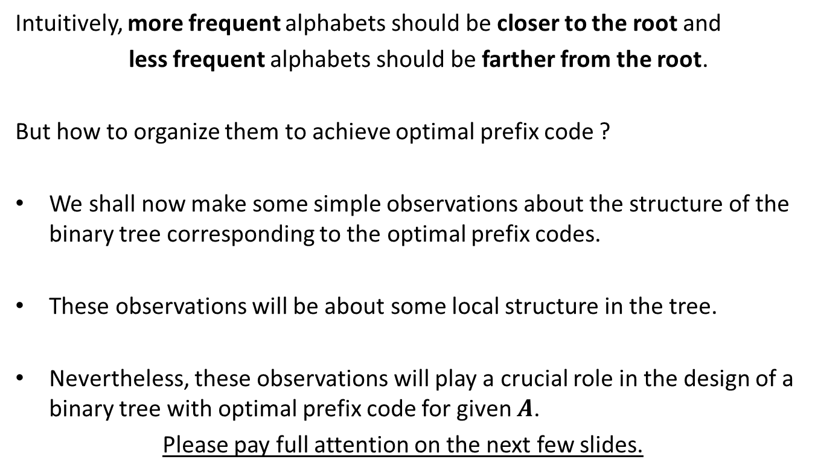
How to prove $OPT_{ABL}\left(A\right)=OPT_{ABL}(A′)$ + $f\left(a_{1}\right)+f\left(a_{2}\right)$ ?
Question: Can we derive a prefix coding for $A$from $OPT(A′)$ ?
Question: Can we derive a prefix coding for $A′$from $OPT(A)$ ?

Slide 13




A prefix coding for $A$from $OPT\left(A^{′}\right)$
$T′$: the binary tree corresponding to $OPT_{ABL}(A′)$
0
1
0
1
0
1
$$T′$$
. . .
1
$a$’

Slide 14

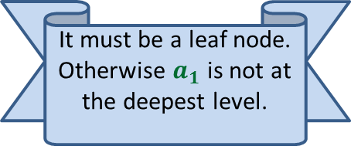

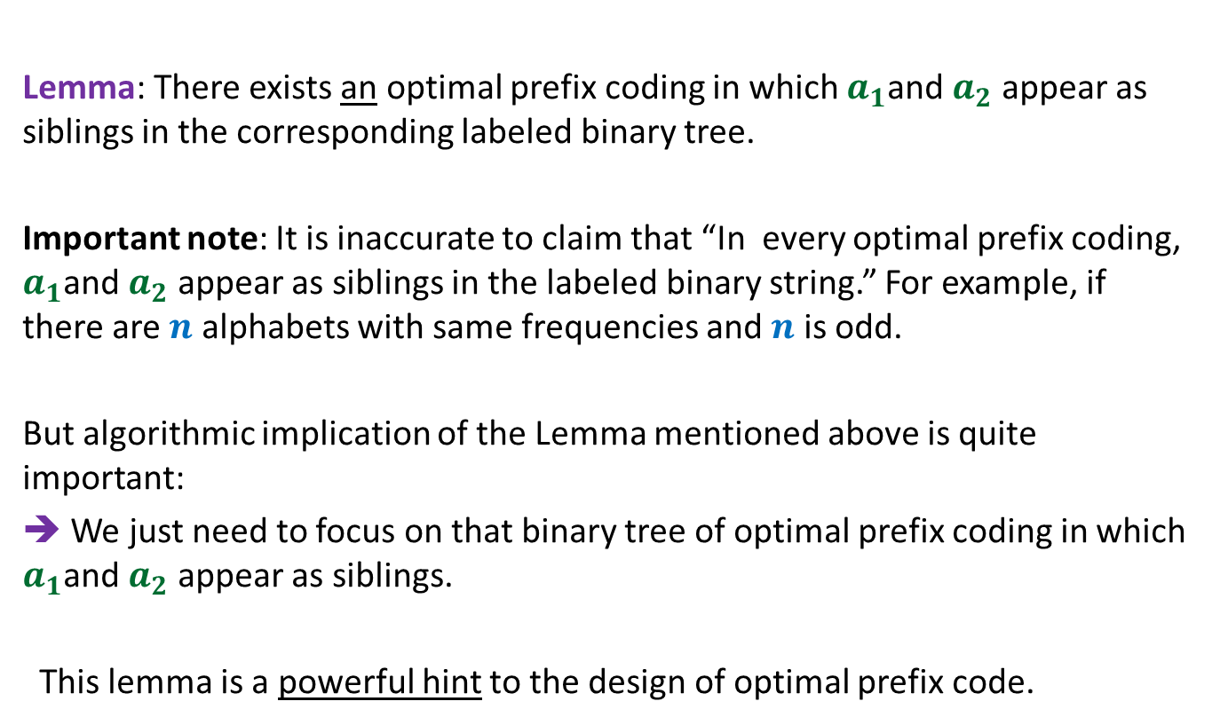


A prefix coding for $A$from $OPT\left(A^{′}\right)$
$T′$: the binary tree corresponding to $OPT_{ABL}(A′)$
This gives a prefix coding for $A$ with $ABL$ = ??
➔ $OPT_{ABL}\left(A\right)≤OPT_{ABL}(A′)$ + $f\left(a_{1}\right)+f\left(a_{2}\right)$
0
1
0
1
0
1
$$T′$$
. . .
1
0
1
$a$’
$$a_{1}$$
$$a_{2}$$
$OPT_{ABL}(A′)$ + $f\left(a_{1}\right)+f\left(a_{2}\right)$

Slide 15





A prefix coding for $A′$from $OPT(A)$
$T$: the binary tree corresponding to $OPT_{ABL}(A)$
0
1
Using Theorem 2
0
1
0
1
$$T$$
. . .
1
0
1
Deepest level
$$a_{1}$$
$$a_{2}$$

Slide 16

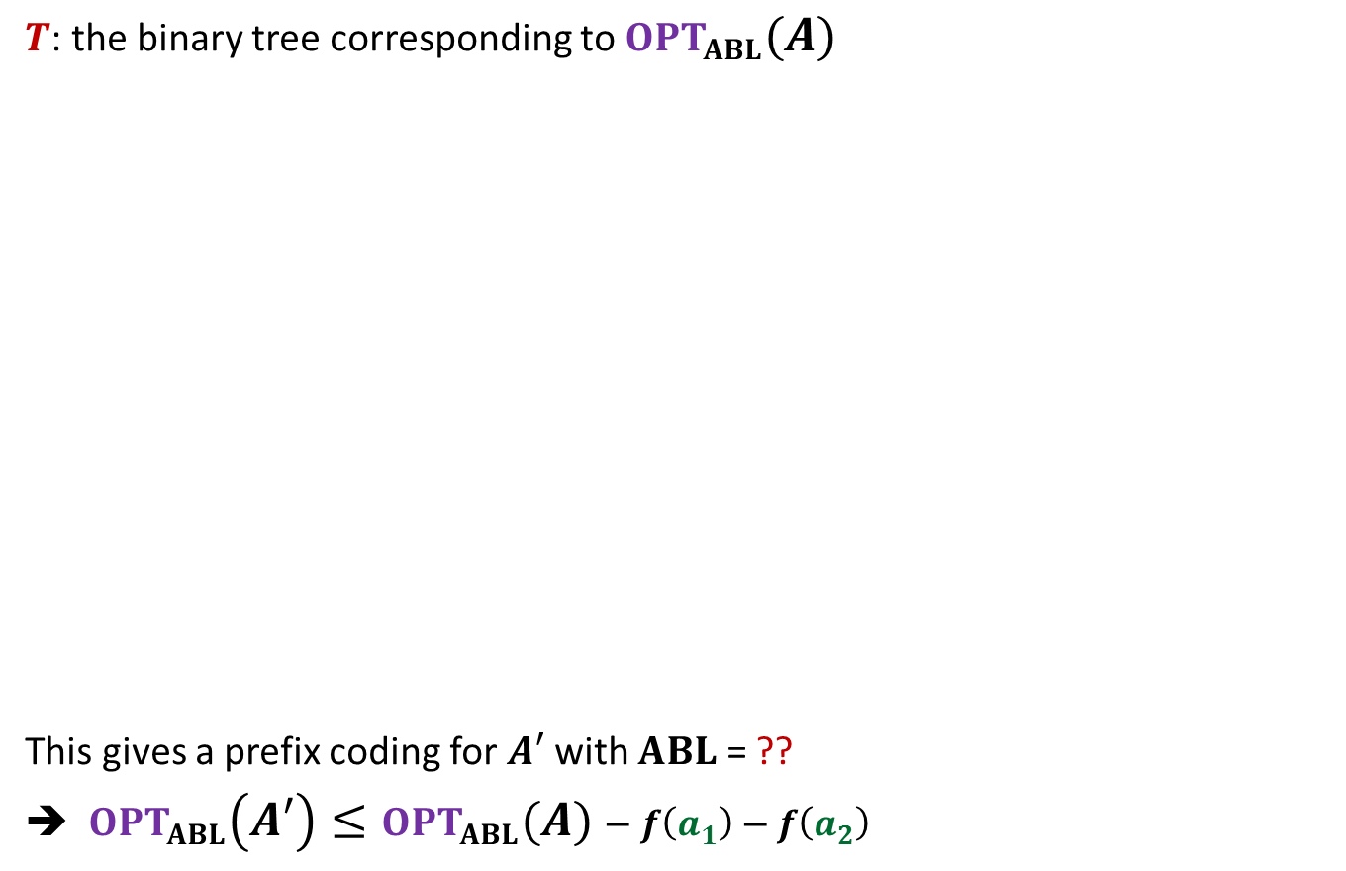

A prefix coding for $A′$from $OPT(A)$
$T$: the binary tree corresponding to $OPT_{ABL}(A)$
This gives a prefix coding for $A′$ with $ABL$ = ??
➔ $OPT_{ABL}\left(A′\right)≤OPT_{ABL}(A)−f\left(a_{1}\right)−f\left(a_{2}\right)$
0
1
Using Theorem 2
0
1
0
1
$$T$$
. . .
1
0
1
$a$’
Deepest level
$$a_{1}$$
$$a_{2}$$
$$OPT_{ABL}\left(A\right)−f\left(a_{1}\right)−f\left(a_{2}\right)$$

Slide 17
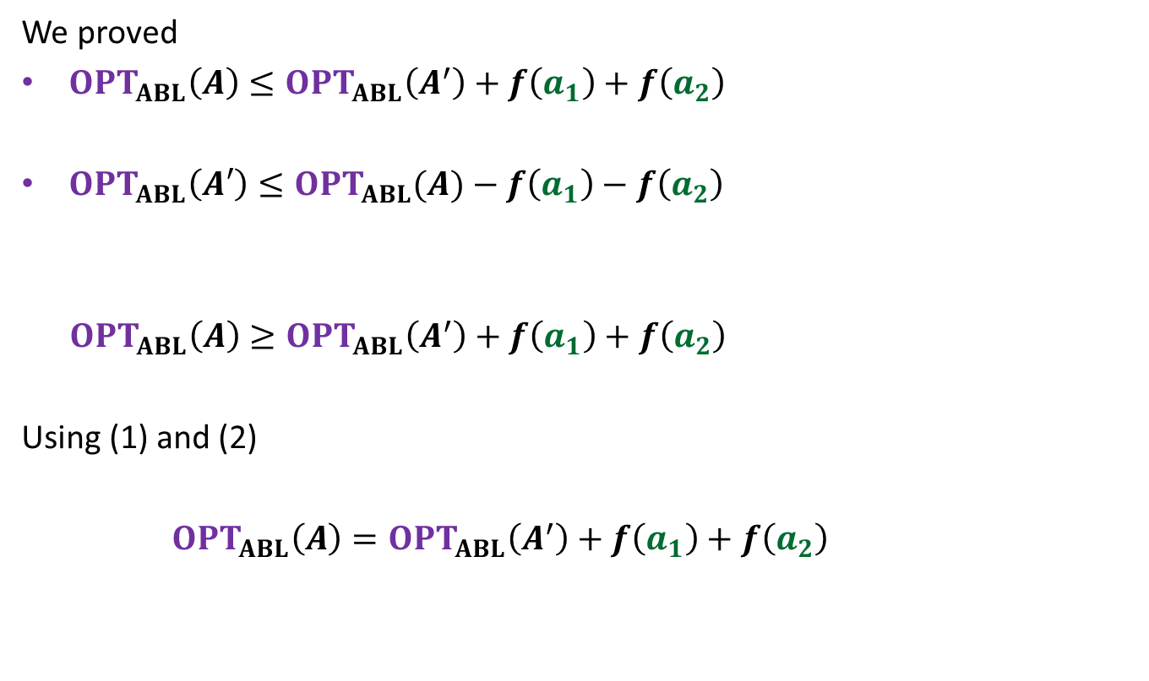
We proved
$OPT_{ABL}\left(A\right)≤OPT_{ABL}\left(A^{′}\right)+f\left(a_{1}\right)+f\left(a_{2}\right)$
$OPT_{ABL}\left(A′\right)≤OPT_{ABL}(A)−f\left(a_{1}\right)−f\left(a_{2}\right)$
$OPT_{ABL}\left(A\right)≥OPT_{ABL}\left(A^{′}\right)+f\left(a_{1}\right)+f\left(a_{2}\right)$
Using (1) and (2)
$OPT_{ABL}\left(A\right)=OPT_{ABL}\left(A^{′}\right)+f\left(a_{1}\right)+f\left(a_{2}\right)$
(1)
(2)

Slide 18

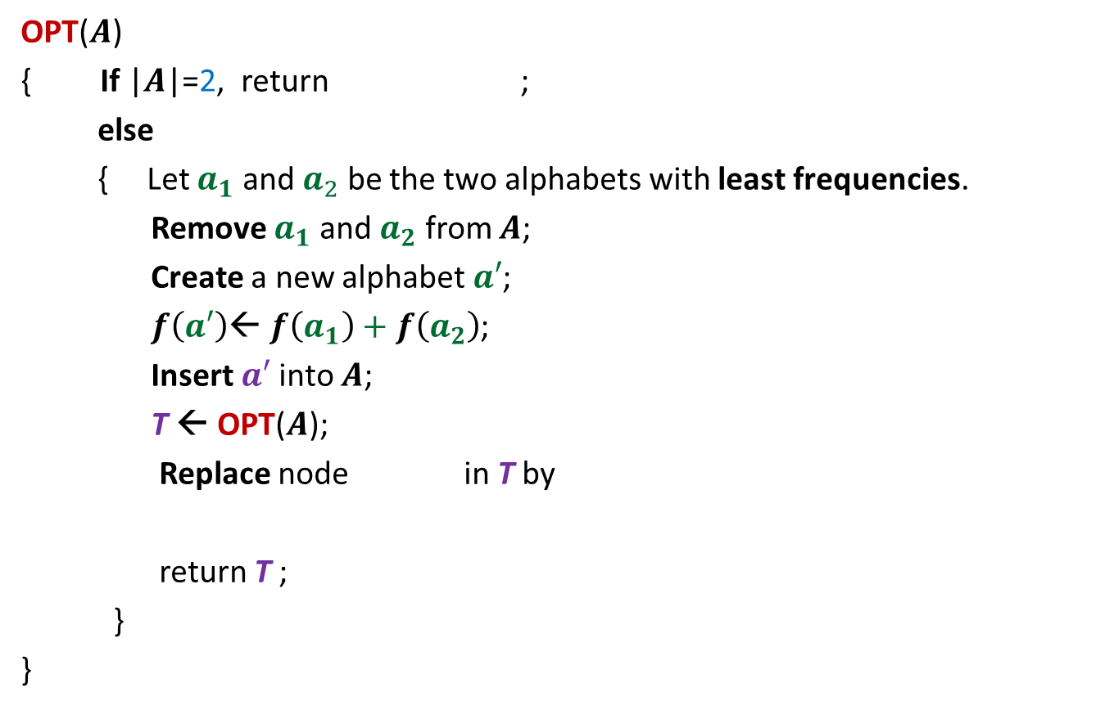





The algorithm based on $OPT_{ABL}\left(A\right)=OPT_{ABL}(A′)$ + $f\left(a_{1}\right)+f\left(a_{2}\right)$
OPT($A$)
{ If |$A$|=2, return ;
else
{ Let $a_{1}$ and $a_{2}$ be the two alphabets with least frequencies.
Remove $a_{1}$ and $a_{2}$ from $A$;
Create a new alphabet $a′$;
$f\left(a′\right)$← $f\left(a_{1}\right)+f\left(a_{2}\right)$;
Insert $a′$into $A$;
T ← OPT($A$);
Replace node in T by
return T ;
}
}
0
1
$$a_{1}$$
$$a_{2}$$
0
1
$a$’
$$a_{1}$$
$$a_{2}$$

Slide 19
Example Minimum spanning tree

Slide 20

instance $A$
170
54
33
63
35
50
70
31
41
81
64
78
53
42
52
80
49
54
42
60
44
43
50
30
49
57
29
102

Slide 21

instance $A$
Theorem 1 : There is an MST($A$) with edge (u,v)
170
54
33
63
35
50
70
31
41
81
64
78
53
42
52
80
49
54
42
60
44
43
50
30
49
57
u
29
102
v

Slide 22


instance $A′$
Theorem 1 : There is an MST($A$) with edge (u,v)
170
54
33
63
35
50
70
31
41
81
64
78
53
42
52
80
49
54
42
44
60
43
50
30
49
57
w
102

Slide 23
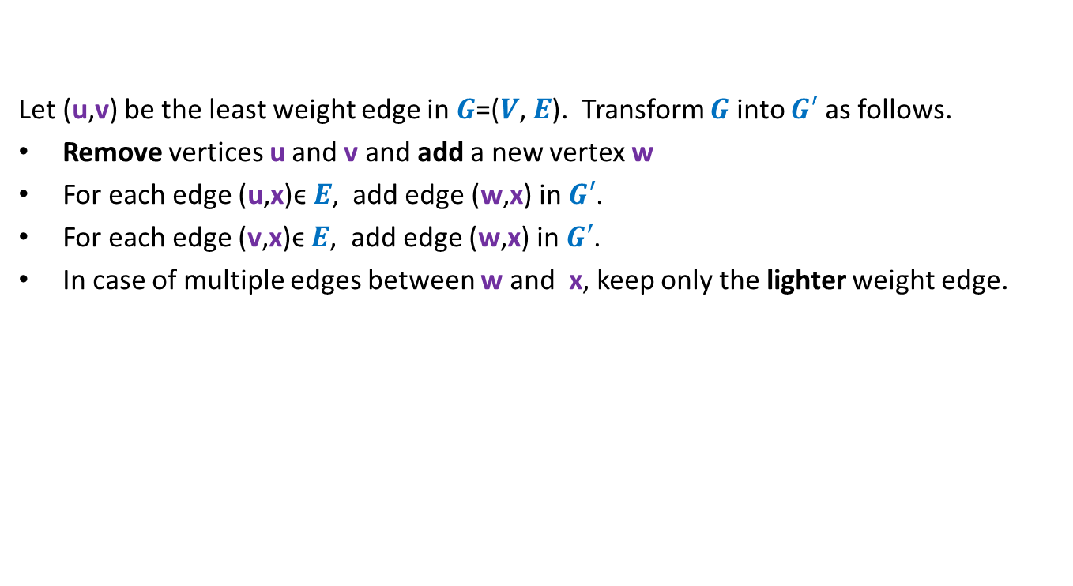

How to compute instance $A′$ ?
Let (u,v) be the least weight edge in $G$=($V$, $E$). Transform $G$ into $G′$ as follows.
Remove vertices u and v and add a new vertex w
For each edge (u,x)ϵ $E$, add edge (w,x) in $G′$.
For each edge (v,x)ϵ $E$, add edge (w,x) in $G′$.
In case of multiple edges between w and x, keep only the lighter weight edge.

Slide 24




Homework
Weight of MST($A$) $=$ Weight of MST($A′$) $+$w(u,v)
In the rest of the lecture, we shall discuss a technique which will also help you do this homework.
MST($A$)
$$A$$
Greedy
step
How ?
Using Theorem 1
MST($A′$)
$$A′$$

